Slide 1

Sanitation Hackathon
By GenioSol

Slide 2
Group Members
Imran Khalil (Group Leader)
Syed Muhammad Umair
Hassan Ali Anjum
Aman Ullah Usmani (Presenter)
Mansoor Jafar

Slide 3
Problem Statement
A system that engages citizens to report ware and sanitation problems to the municipality compelling them to respond quickly.

Slide 4
Proposed Solution
A system features issue ticketing system, allowing end user to report and track issues about water and sanitation problems quickly and easily.
The solution comprised of:
Android Mobile app
Web Application

Slide 5
What we have NOW?
Currently the System is at following stage:
Web Application
New Users, Add roles (Portal Admin)
Issue reporting and tracking (End User)
Issue report by operator (Help line operator)
Android Application
Login for Supervisor
User issue reporting

Slide 6
What we have NEXT?
Web Application
Issue tracking on SMS
Accountability, Performance Graphs
Employees of the month
Accountability factor
Android Application
Issue Progress
Inspection forms for inspection teams.
Voice messages for Issues creation.

Slide 7
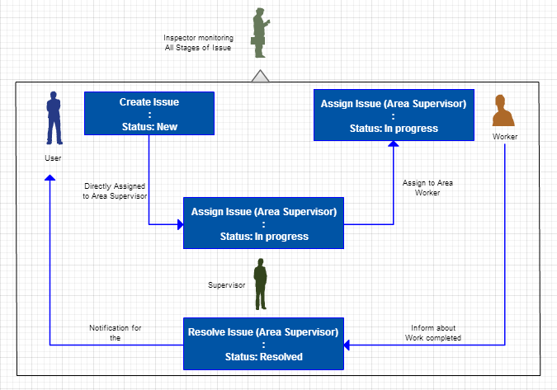
Issue Life Cycle

Slide 8
Real Life Scenario
Mr. Alex is living in NYC and he is facing sanitation problem. He installed our application in his device and he logged a complaint to municipality about the problem. Getting his location, application will assigned the issue to Mr. James (supervisor of respective area i.e. NYC). Mr. James will assigned this task to sanitation team under him. The team will fix the problem and will report Mr. James that they had fixed the problem. Mr. James will mark this issue as Resolved and then a notification will be sent to Mr. Alex that the issue has been fixed. Now, Mr. Alex will provide feedback that will be used in calculating supervisors’ performance.

Slide 9
Accountability Factor
The website’s front page will be showing the overall performance of all supervisors based on
Average Time for Resolving Issues
% of issues solved
User Feedback Scoring

Slide 10
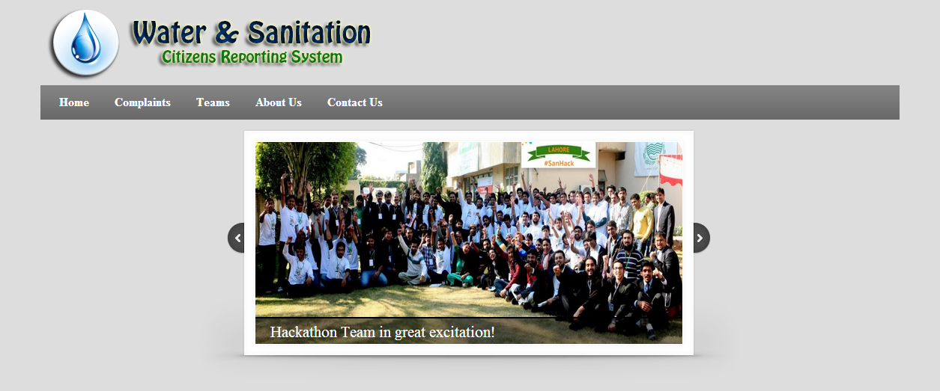
Project Screens
Home Screen

Slide 11
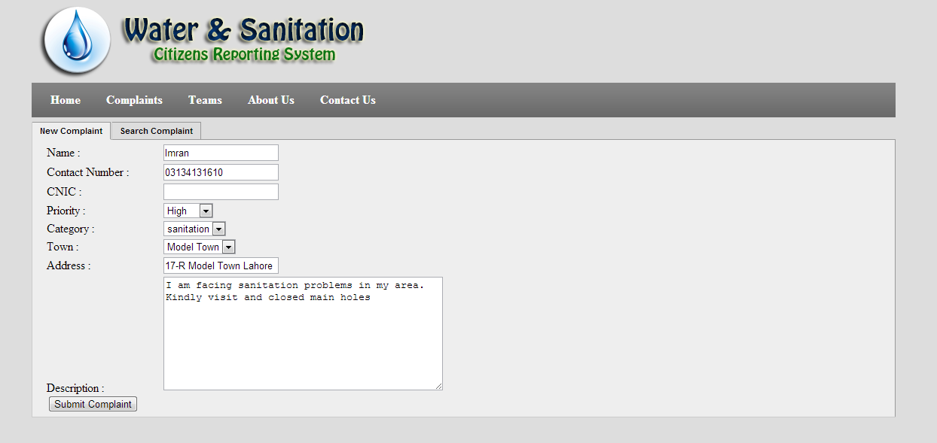
Project Screens
Registering Complaint

Slide 12
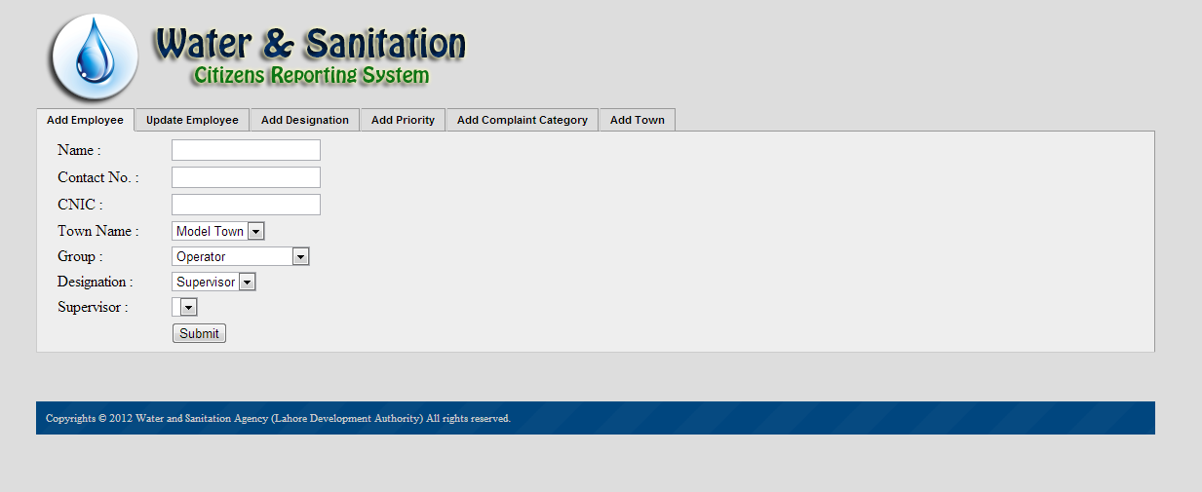
Project Screens
Admin View

